Slide 1

Welcome
Project
Online Quiz Maker
ID: 171-35-236
ID: 171-35-233
ID: 171-35-198
ID: 171-35-207

Slide 2
Contents:
-Why online quiz maker.
-Final Project outcome.
-Technology we used.
-Features.
-Future Update Feature
-Conclusion.

Slide 3

Why online Quiz maker?
The online quiz maker is a web application for to take online test in an efficient manner and no time wasting for checking the paper. The main objective of online quiz maker is to efficiently evaluate the candidate thoroughly through a fully automated system that not only saves lot of time but also gives fast results. For students they give papers according to their convenience and time and there is no need of using extra thing like paper, pen etc. This can be used in educational institutions as well as in corporate world. Can be used anywhere any time as it is a web based application(user location doesn’t matter). No restriction that examiner has to be present when the candidate takes the test.

Slide 4
Project progress:
Project Proposal
Use Case Diagram
Sequence Diagram
Activity Diagram
Use Case Description
Software Requirement Specification (SRS)
DFD Diagram
ER Diagram
Database Design
Database Design
Prototype Design
Database Implementation
Front-end Design
Login with Back-end
Register with Back-end
Create Exam
Make Question
Creating Quiz
History
Give Exam
Already Done
Result show
Update Question
Authentication

Slide 5
Project Outcome:
The expected outcome from the successful implementation of the project :
• Teachers / question setters will be able to create question scripts easily with efficiency.
• All information about questions will be recorded.
• Teachers / question setters will be able to generate pre settled question scripts anytime.
• Sharing of question paper will be easier and more secure.
• Making different set of questions will be easier.

Slide 6






Technology we used:
Database. Front-end: Blade template, HTML, CSS, Bootstrap, JavaScript
Back-end: PHP, JavaScript
Database: MySQL
Query language: ​Structured Query Language (​SQL)
This project is a web application that is developed in Laravel 6.0 with MySQL

Slide 7
Features:
-Create Exam
-Marks
-History
-Give Exam
-Result
-Authentication

Slide 8
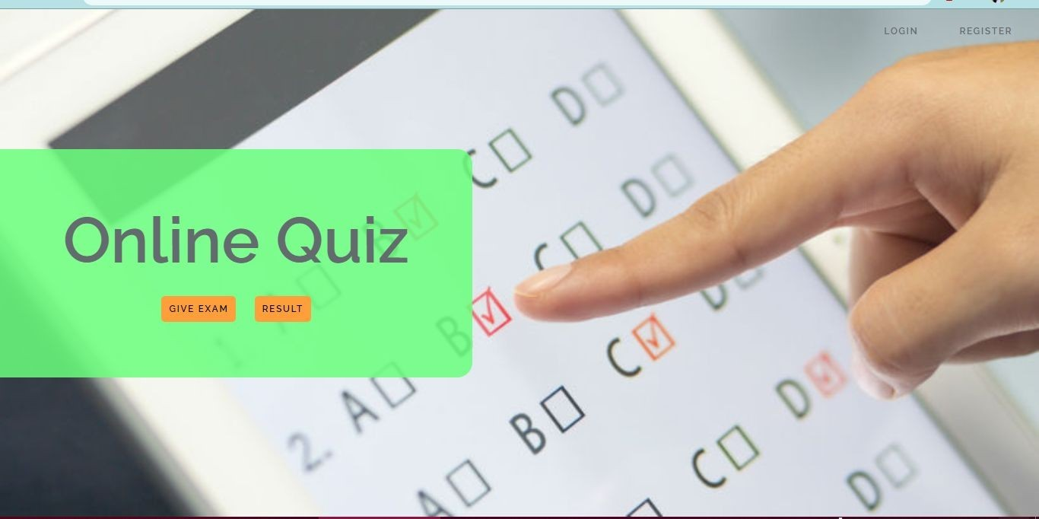
Student Dashboard:

Slide 9
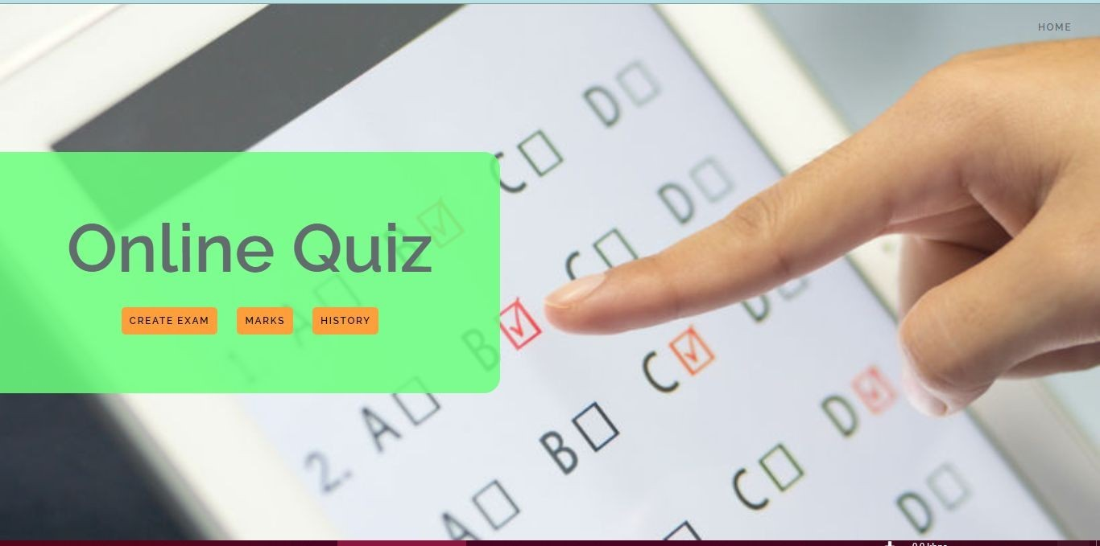
Teachers Dashboard:

Slide 10
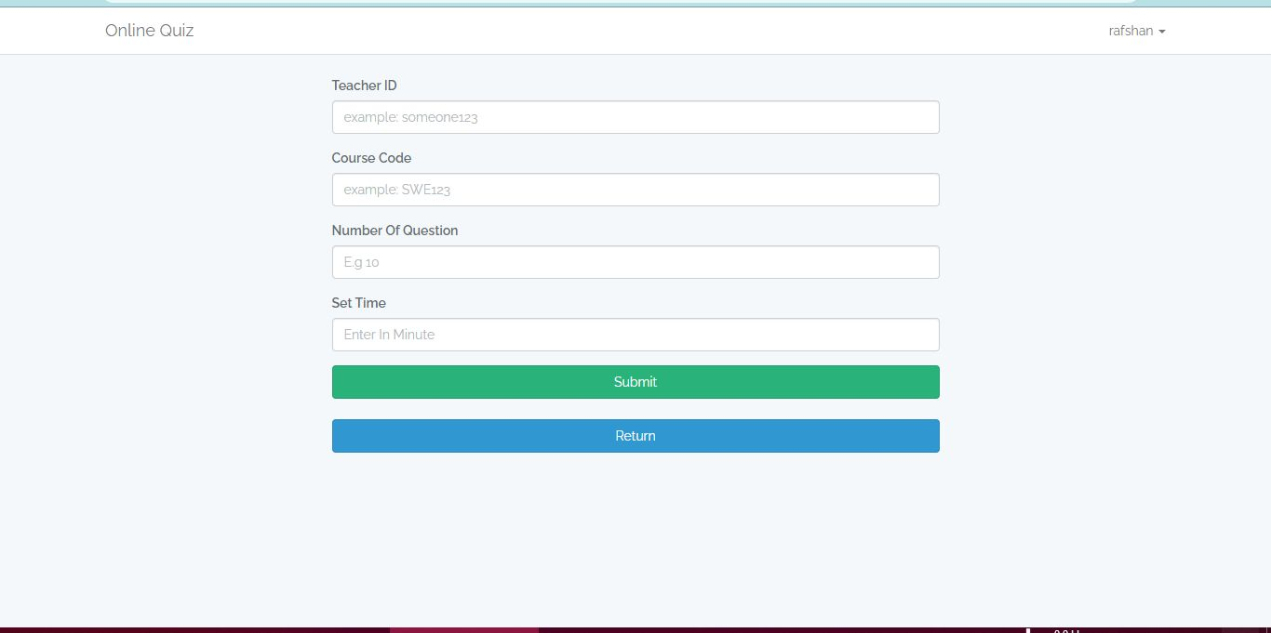
Creating Quiz:

Slide 11
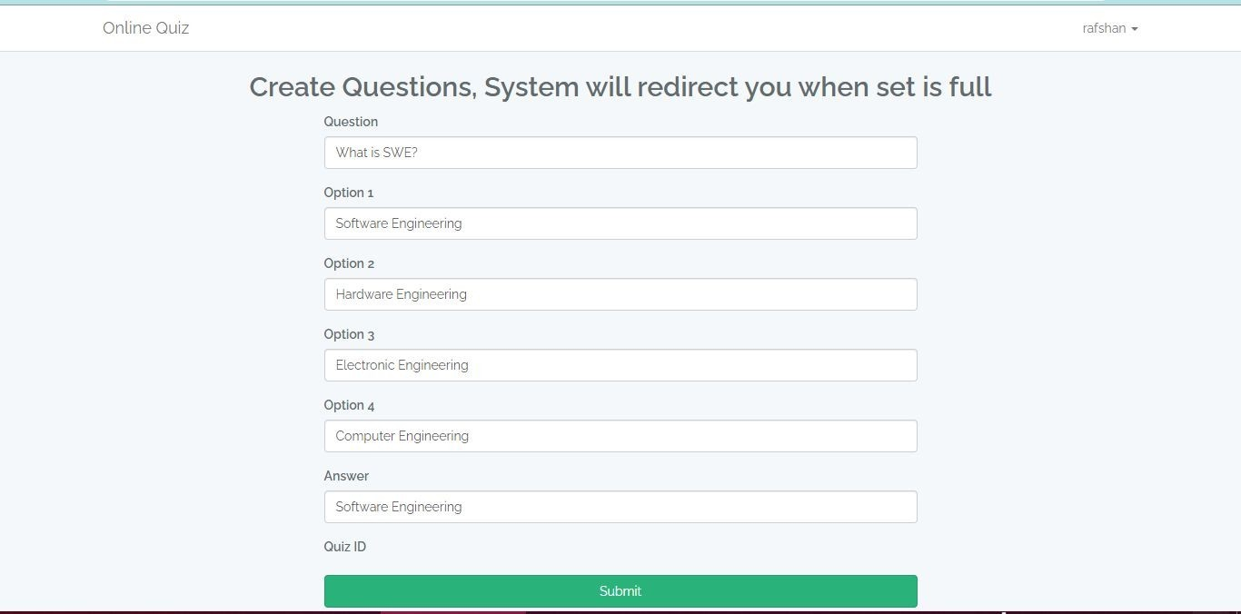
Create Questions:

Slide 12
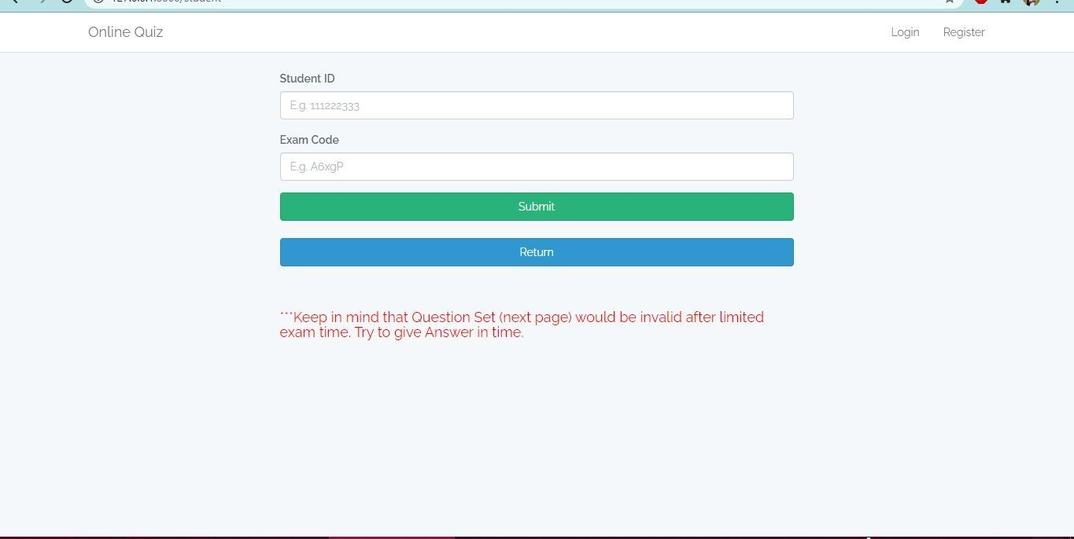
Give Quiz:

Slide 13
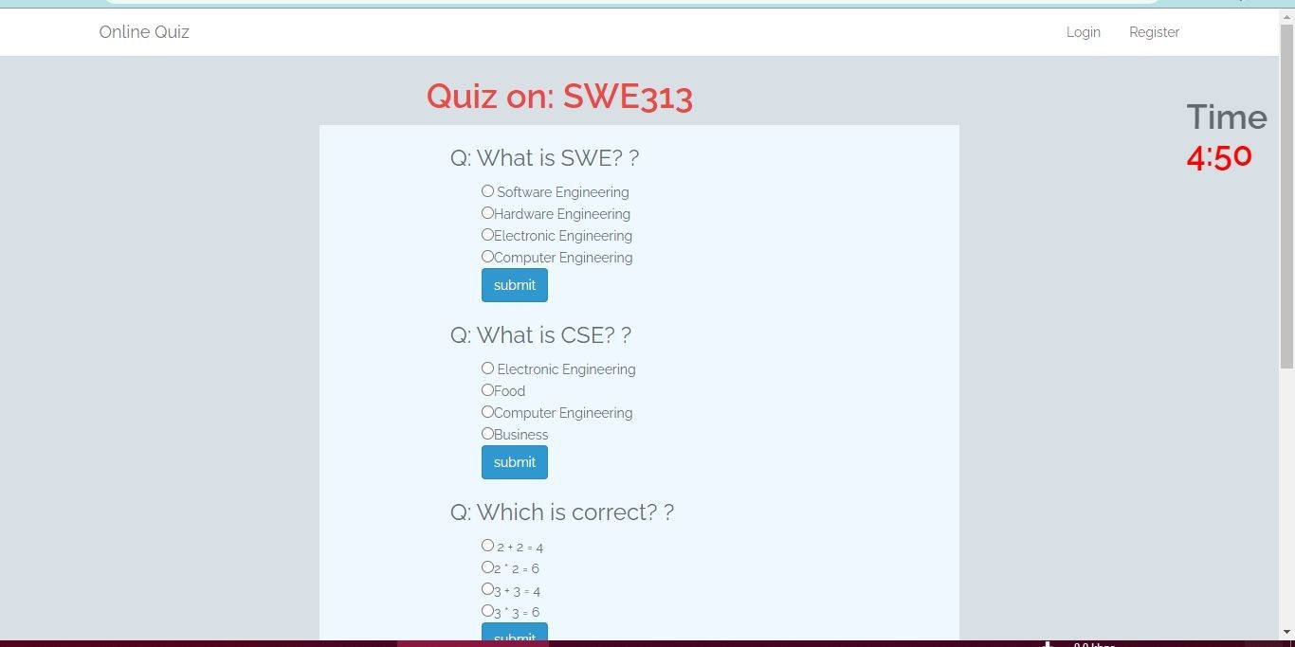
Giving Quiz:

Slide 14
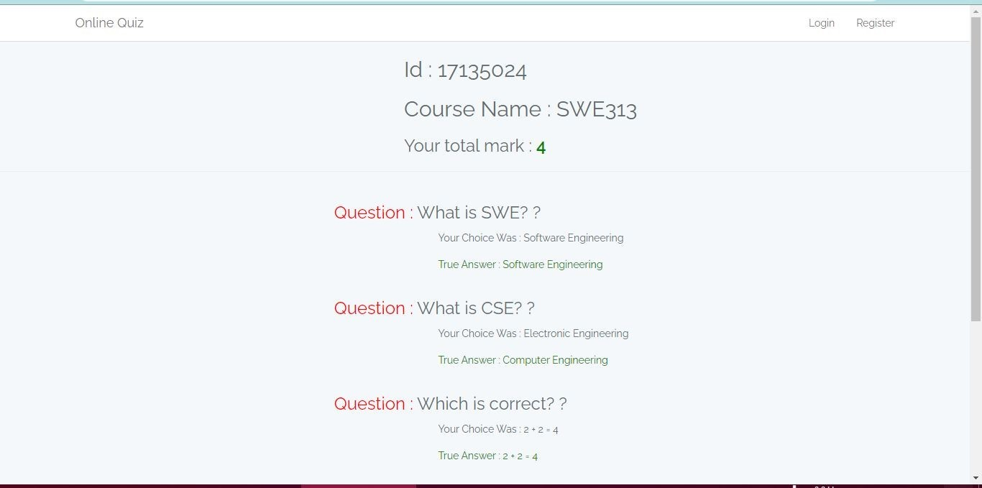
Student Result:

Slide 15
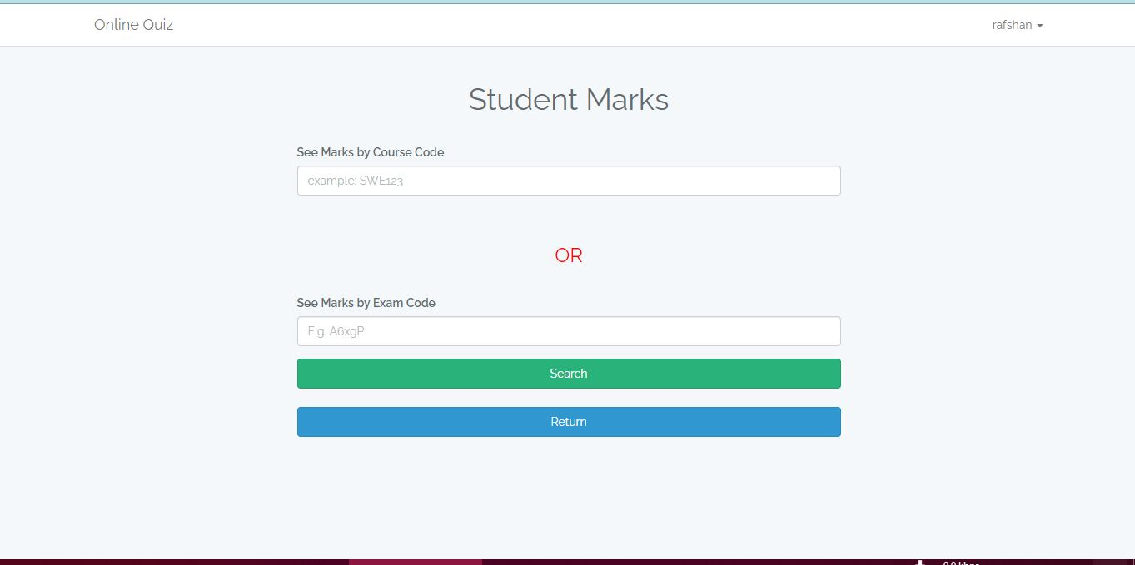
Teacher Marks Search:

Slide 16
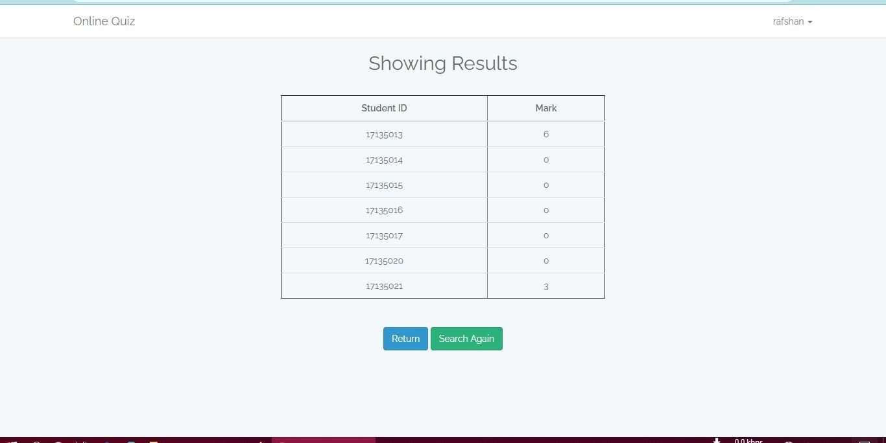
Teacher marks show:

Slide 17
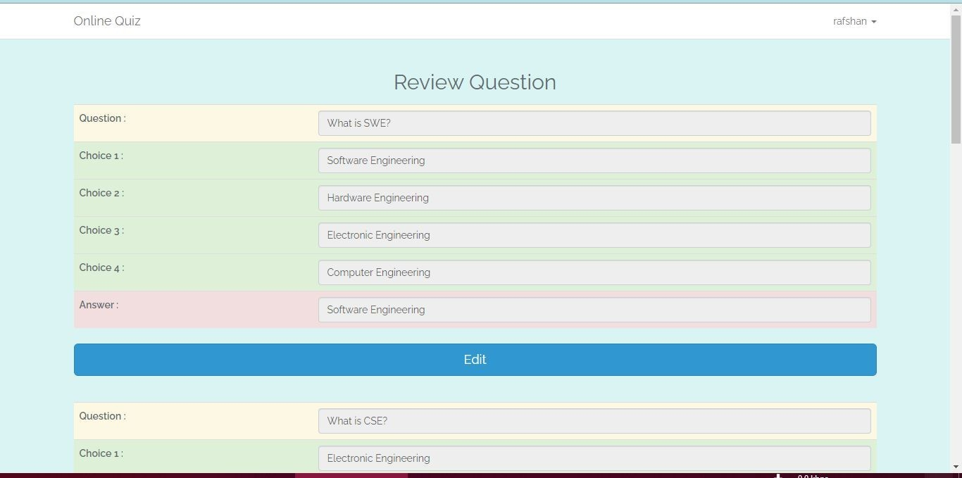
Question Review:

Slide 18
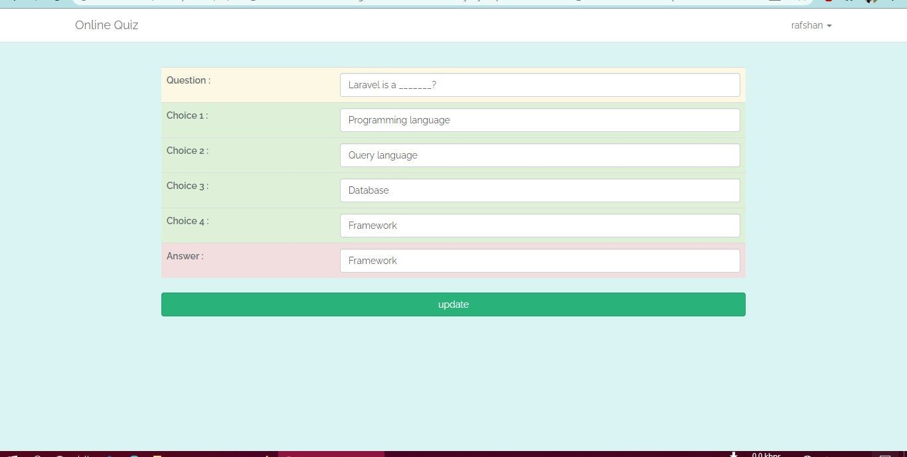
Update Question:

Slide 19
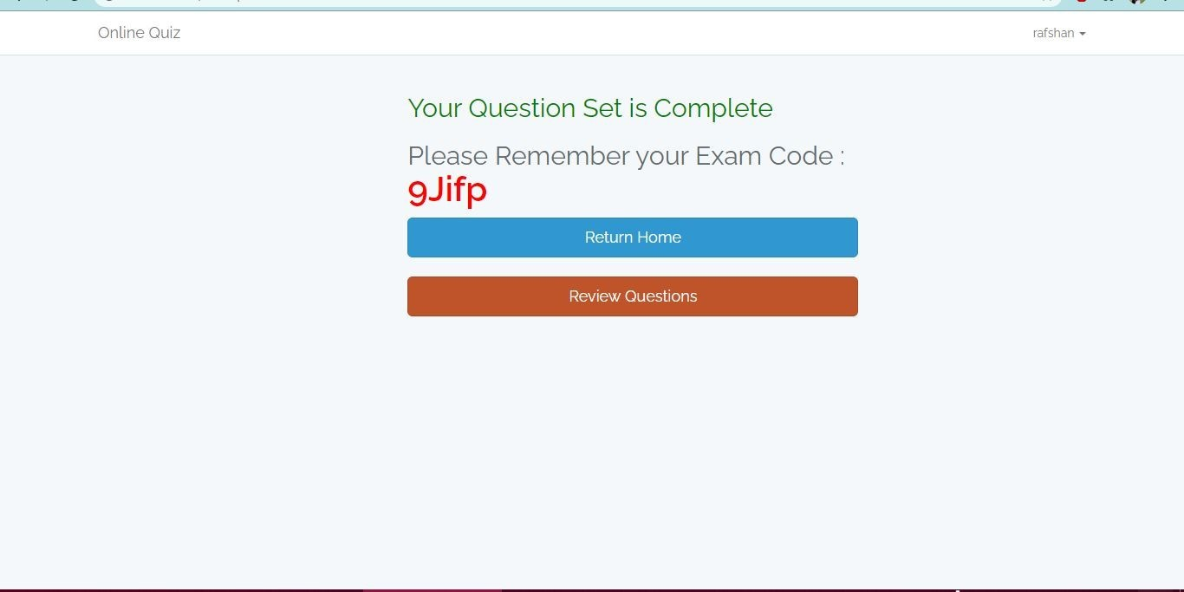
Receive Exam code:

Slide 20
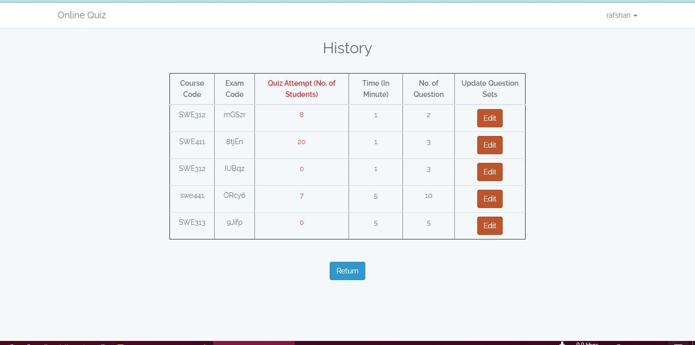
Previous Records:

Slide 21
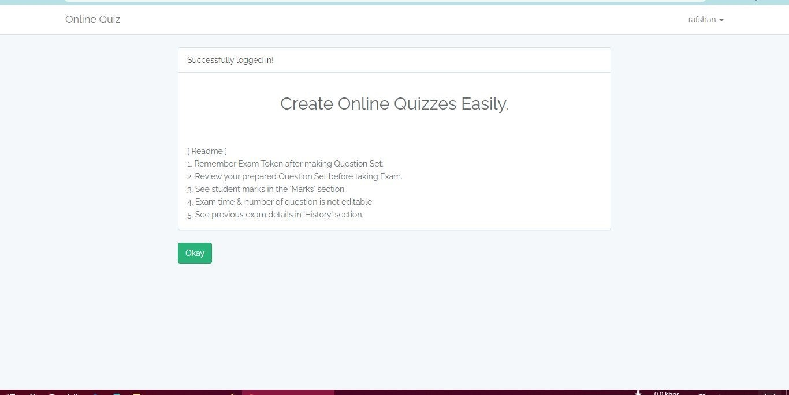
Welcome screen after login/register

Slide 22
Future Update Feature:
-Connected chatbots on Facebook Messenger.
-Using QR code
-Grade and score automatically.
-Create fun-to-play quizzes
-Create engaging quizzes with video and audio, voice-overs, text-to-speech, etc.

Slide 23
Conclusion:
Online Quiz Maker is a user friendly system, which is very easy and convenient to use. The system is complete in the sense that it is operational and it is tested by entering data and getting the reports in proper order. But there is always a scope for improvement and enhancement. During the development of this,coding standards are followed for easy maintainability and extensibility.

Slide 24
Thank You

